Slide 1



Clustering Performance vs Data Size
By Nevaeh Zumbrun, Jacob Batton and Patriya Murray

Slide 2
Problem and Objective
Objective: Determine the best algorithm as the data size grows
Compare clustering algorithms:
DBSCAN
K-means
Firefly algorithm (Nature-inspired)
Hierarchical clustering
Evaluate Performance using:
Memory Usage
Runtime
Accuracy (Silhouette score)
Scalability

Slide 3
Methods and Implementation
Implementation
Python
Generate graphs for each metric
10 Trials per algorithm
Measure silhouette score
Datasets
Iris Dataset (150 datapoints)
Synthetic Dataset (200-20000 datapoints)

Slide 4
Algorithm Overview
Algorithm | Type | Goal
K-means | Centroid-based | Group around center
DBSCAN | Density-based | Find Dense regions
Hierarchical | Connectivity-based | Create cluster hierarchy
Firefly | Nature-Inspired | Use attraction between points

Slide 5
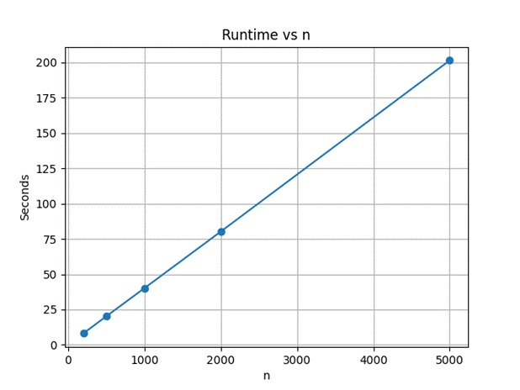
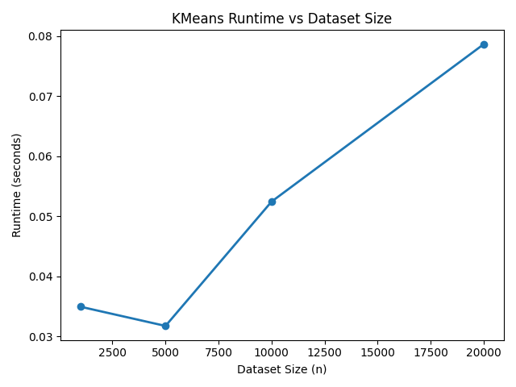
Runtime comparison
Firefly
K-means has the fastest runtime as n increases
Hierarchical had a moderate runtime increase
DBSCAN is slightly faster than Hierarchical
Firefly has the slowest run time as n increases

Slide 6
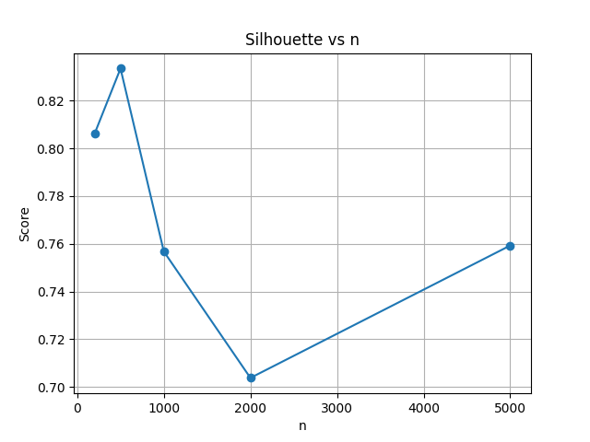
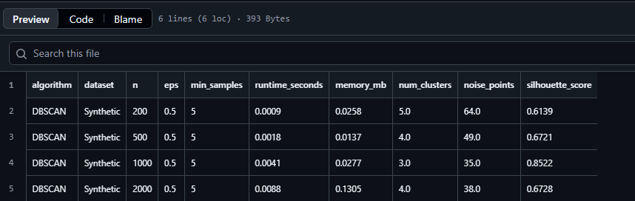
Accuracy
Firefly
Firefly had inconsistent silhouette scores
Hierarchical scores decreased as n increases
K-means had consistently high silhouette scores
DBSCAN produced the highest silhouette scores on average with the right parameters

Slide 7
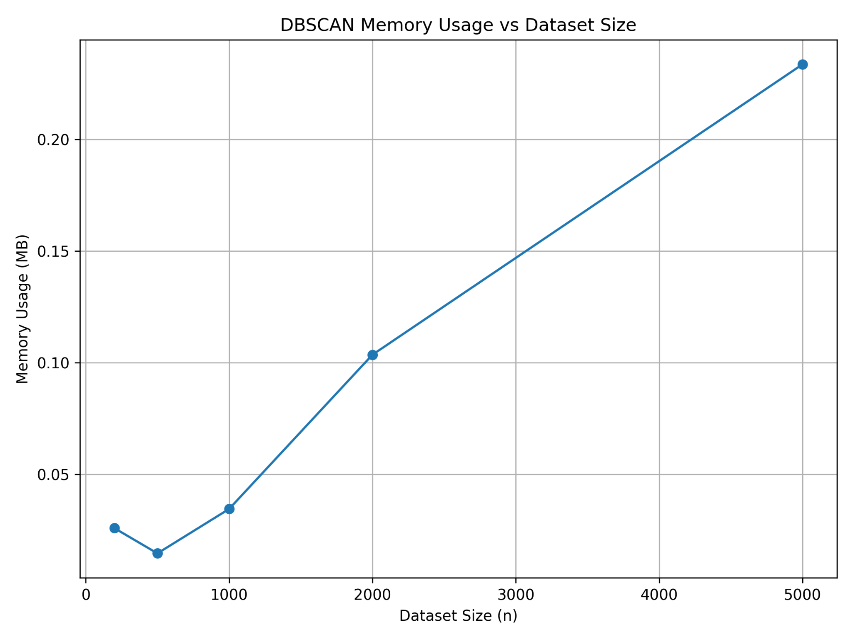
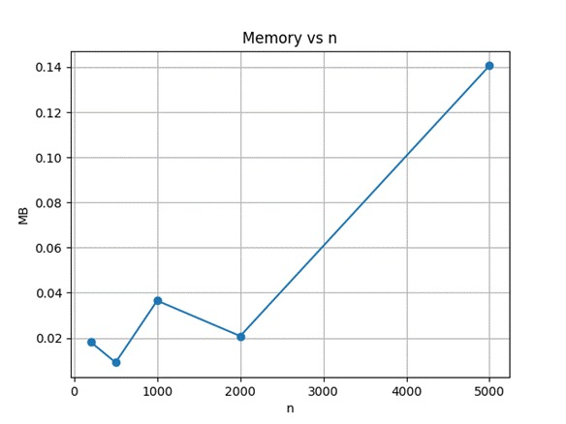
Memory Usage
All algorithms had increased memory usage as the dataset size increased.
Fluctuations were likely due to system memory allocation
Firefly

Slide 8
Scalability ratings
K-means (1)
DBSCAN (2)
Hierarchical (3)
Firefly (4)

Slide 9
The “best” clustering algorithm
Fastest runtime: K-means
Best accuracy: DBSCAN
Best Scalability: K-means
Worst as dataset size increases: Firefly

Slide 10
Q & A Time
Any questions?

